Slide 1
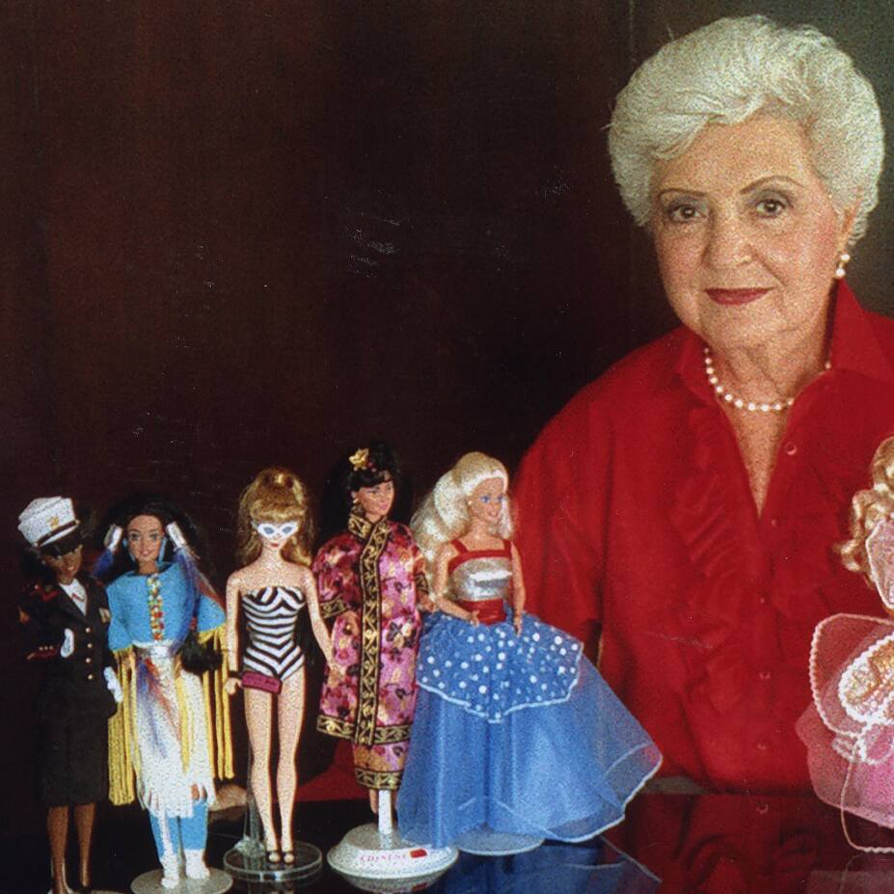
Ruth Handler The inventor of Barbie

Slide 2
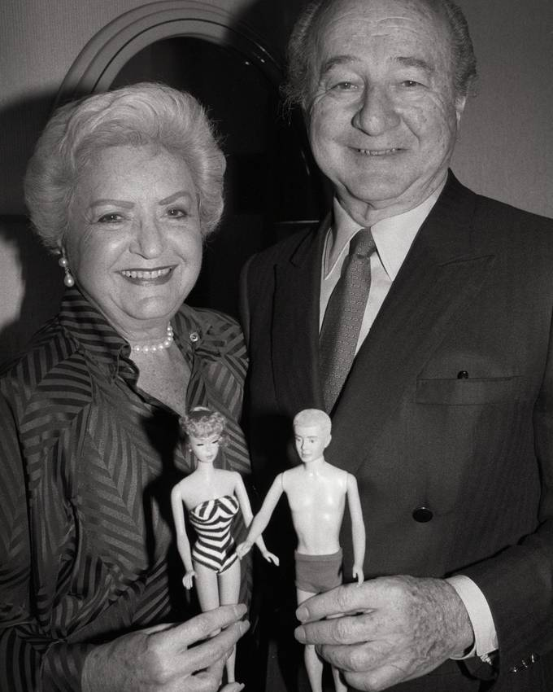
Born in 1896
married school boyfriend Elliot at 21
moved to hollywood together

Slide 3
MATTEL
Elliot founded company „MATTEL“ during 2. World war
they sold furniture, „knick knacks“ and plastic toys

Slide 4
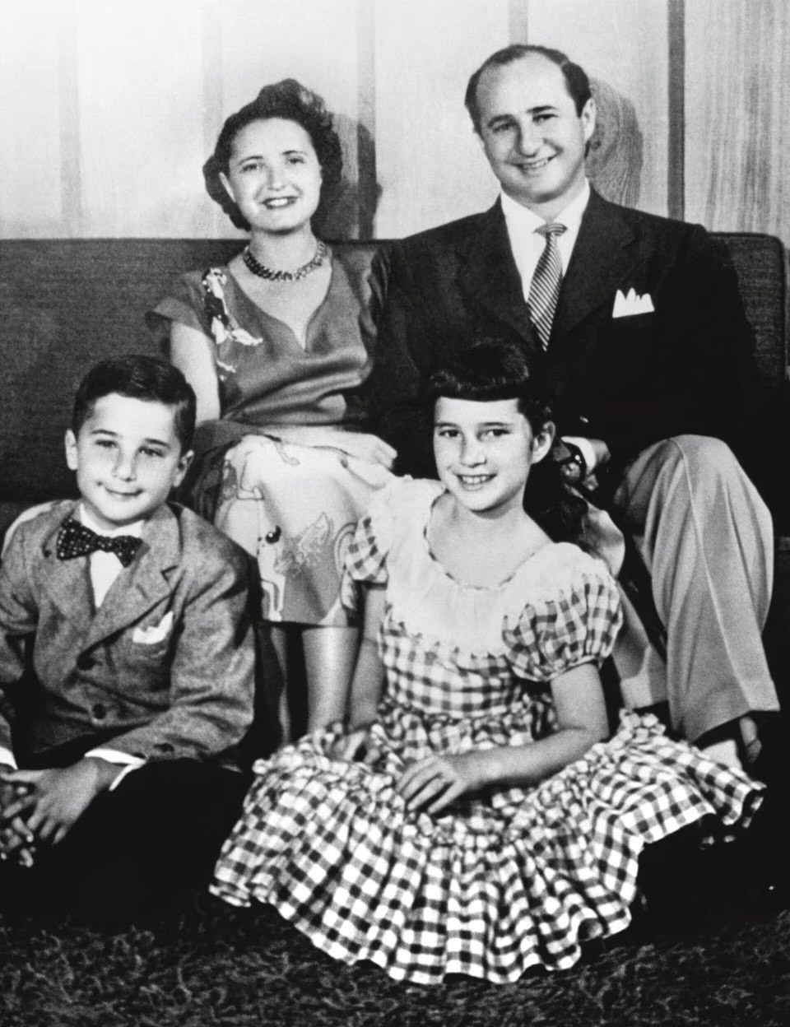
Ruths children Kenneth & Barbera
Barbera did not like playing with Baby born dolls
prefered dolls to dress up

Slide 5
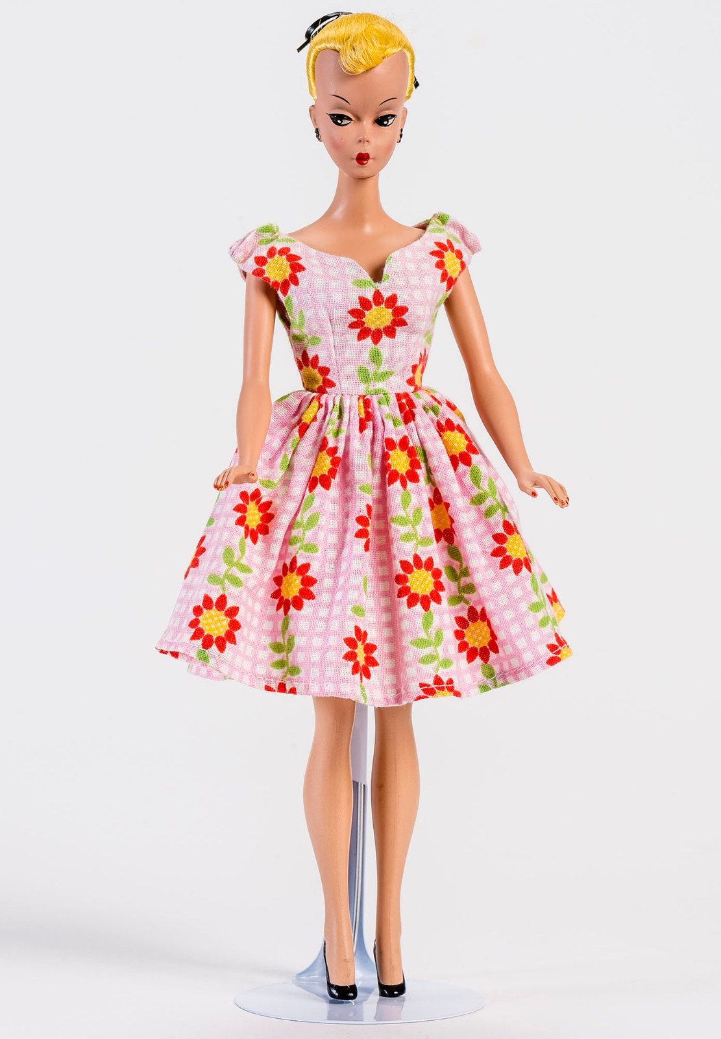
Bild-Lilly
Ruth found „Bild-Lilly“ on a trip in 1956
Idea for the Barbie was born

Slide 6
The Barbie came onto the market at 1959

Slide 7
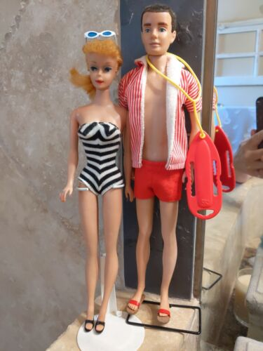
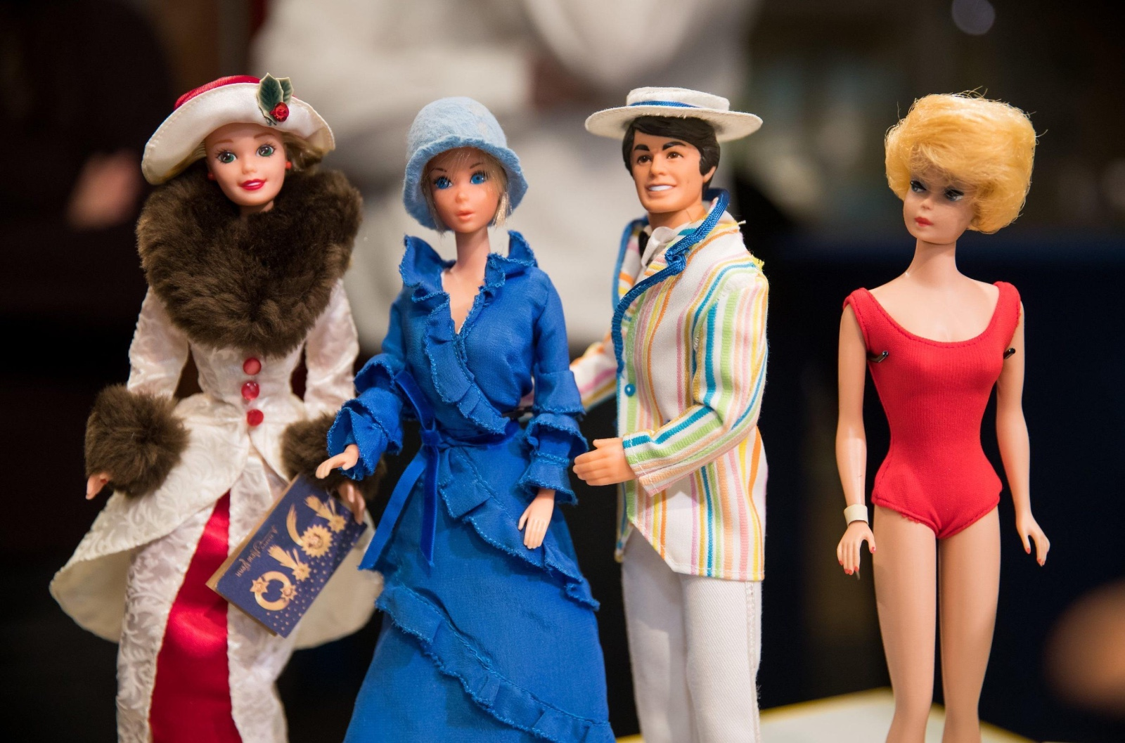
First Barbies

Slide 8
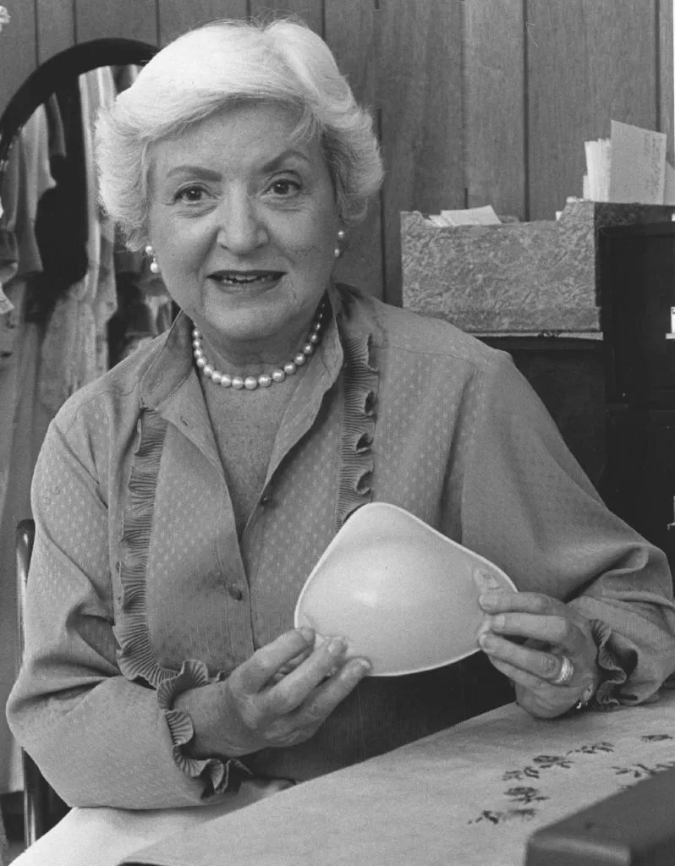
She suffered from breast cancer in 1960
suffered from breast cancer in 1960
had to remove a breast

Slide 9
„Nearly me“
could not find good breast protheses
founded „Nearly me“ and made comfortable breast protheses

Slide 10
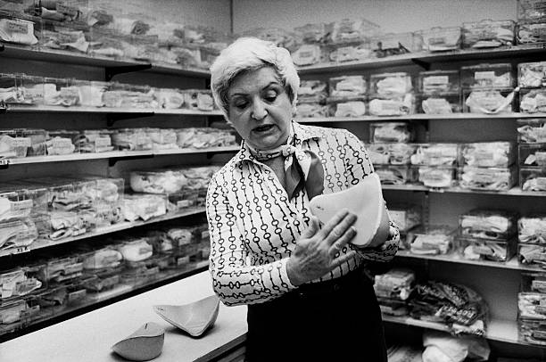
The End
sold the company for a huge Profit
died 11 years later at the age of 85

Slide 11
used sources
https://en.wikipedia.org/wiki/Barbie#History
Video 1st Barbie commercial - https://www.youtube.com/watch?v=bQbRaMrqiME
https://en.wikipedia.org/wiki/Ruth_Handler
https://museen.nuernberg.de/ spielzeugmuseum/die-sammlung/highlights-spielzeugmuseum/vash/puppe-bild-lilli

